Slide 1



CUSTOMER CHURN
View in Power BI
Last data refresh:
4/22/2024 10:25:38 AM UTC
Downloaded at:
4/22/2024 10:27:07 AM UTC

Slide 2

WELCOME
Notes:
textbox
No alt text provided

Slide 3
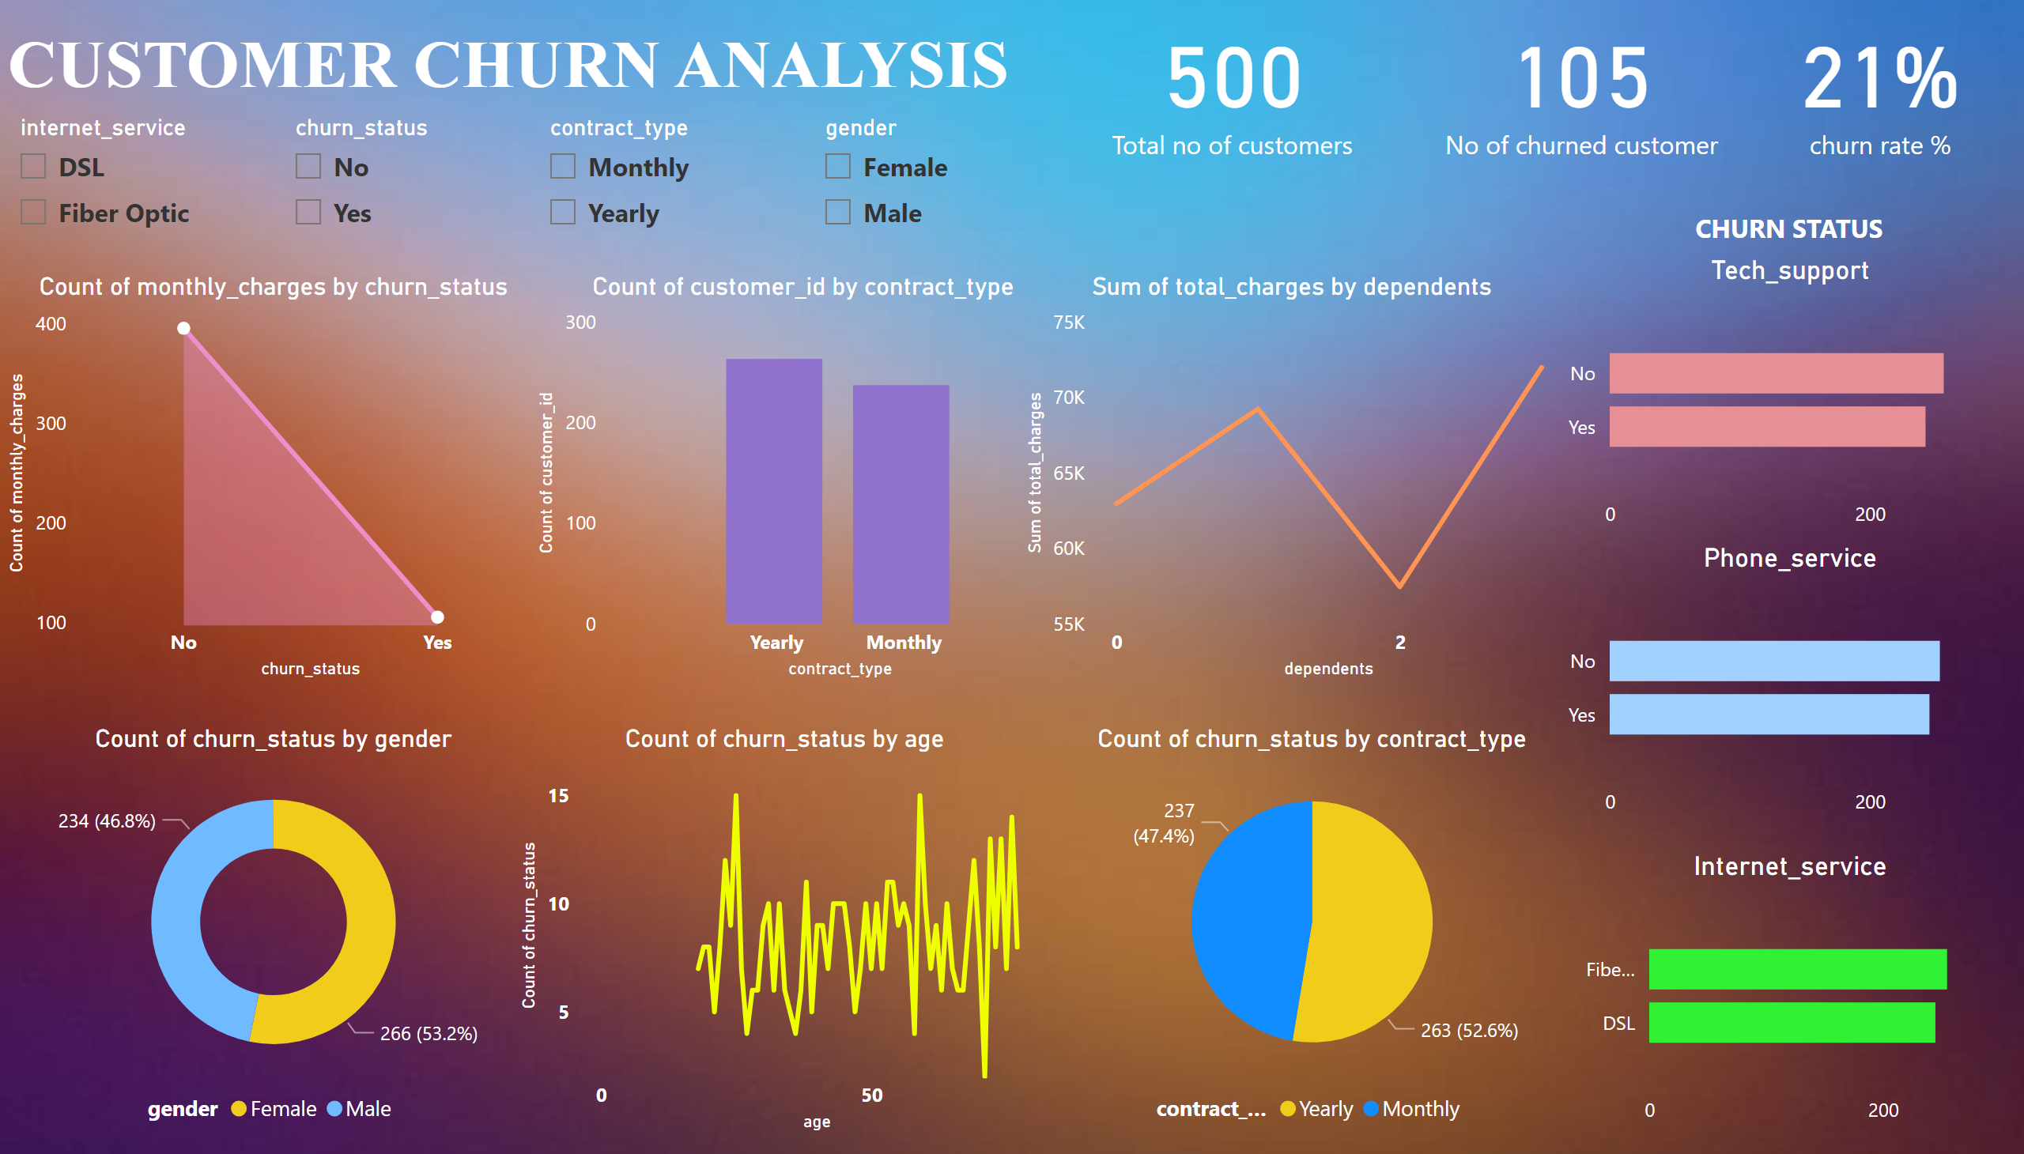
DASHBOARD
Notes:
areaChart
No alt text provided
Phone_service
No alt text provided
lineChart
No alt text provided
pieChart
No alt text provided
Internet_service
No alt text provided
Tech_support
No alt text provided
textbox
No alt text provided
textbox
No alt text provided
card
No alt text provided
card
No alt text provided
card
No alt text provided
donutChart
No alt text provided
clusteredColumnChart
No alt text provided
lineChart
No alt text provided
slicer
No alt text provided
slicer
No alt text provided
slicer
No alt text provided
slicer
No alt text provided

Slide 4
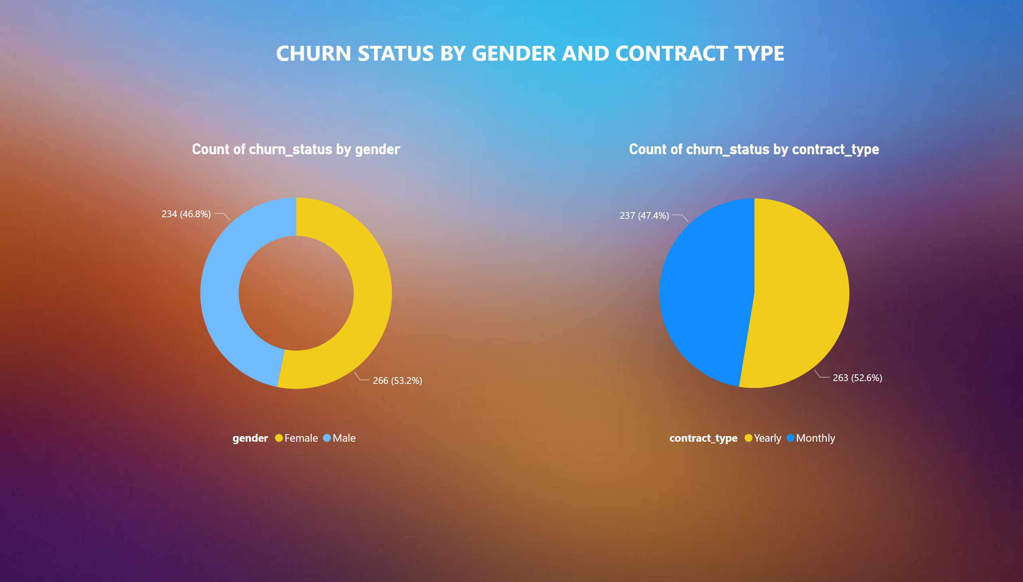
Gender & contract type
Notes:
donutChart
No alt text provided
pieChart
No alt text provided
textbox
No alt text provided

Slide 5
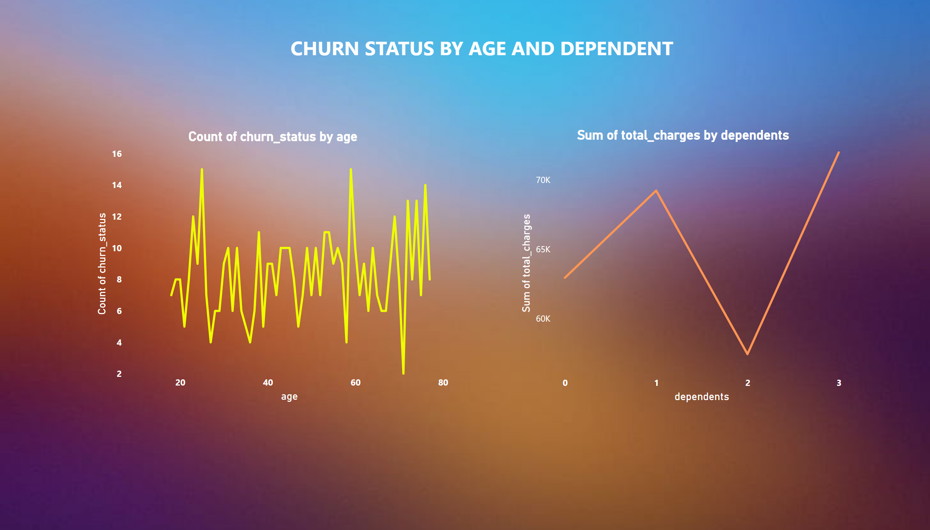
Age & dependents
Notes:
textbox
No alt text provided
lineChart
No alt text provided
lineChart
No alt text provided

Slide 6
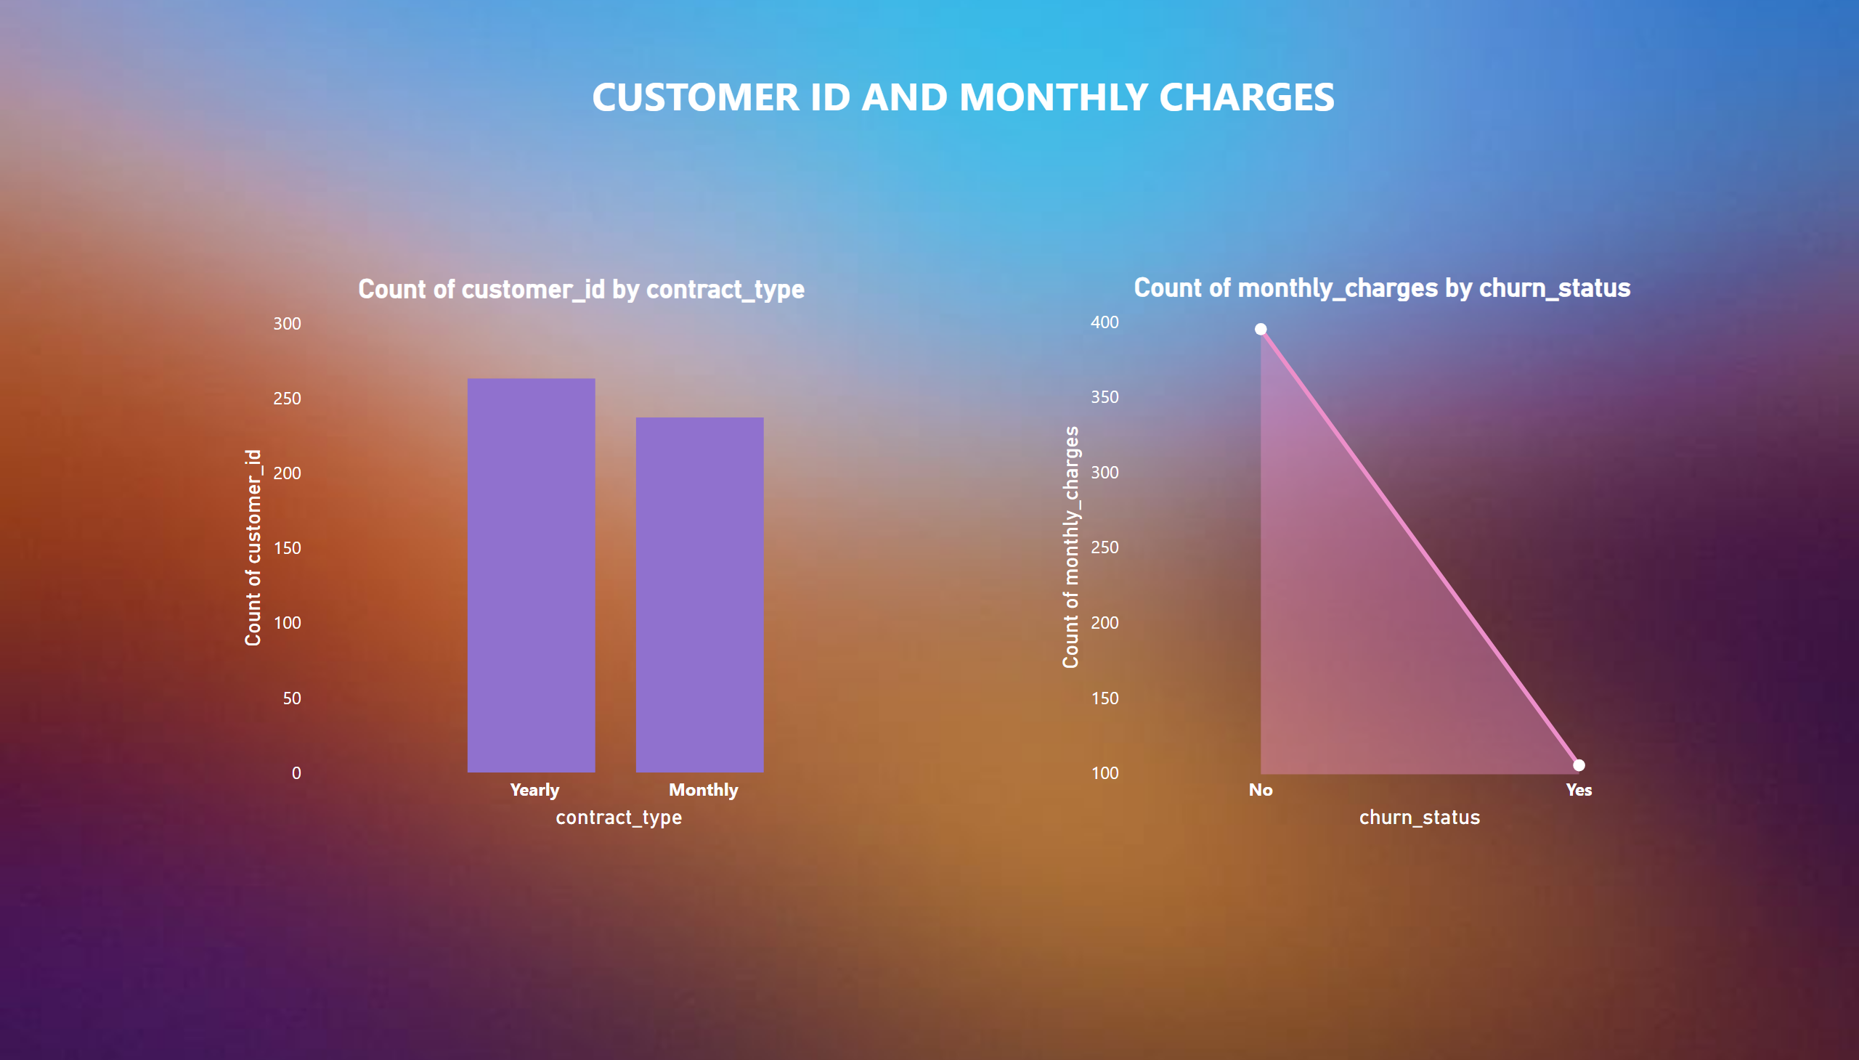
Customer id & monthly charges
Notes:
textbox
No alt text provided
areaChart
No alt text provided
clusteredColumnChart
No alt text provided

